Slide 1


AEMPY: A Python Toolbox for Frequency- and Time-Domain Airborne Electromagnetic Data
of the Tellus Surveys
Duygu Kiyan¹, Volker Rath¹, and Robert Delhaye¹
March 21, 2017

Slide 2
What is AEMPY?
AEMPY is a python toolbox developed for inversion of frequency- and time-domain airborne electromagnetic data of the TELLUS Surveys
IMPLEMENTATION
Python
Modules and Scripts
Numpy, Scipy, Matplotlib
DIAS GIT Repository
Free Access (Coming Soon!)
Notes:
Numpy: is an extension to the Python programming language, adding support for large, multi-dimensional arrays, and matrices along with a large library of high-level mathematical functions to operate on these arrays.
Scipy: is an open source Python library used for scientific computing and technical computing, contains modules for optimisation, linear algebra, integration, interpolation, FFT, signal processing
Matplotlib: is a plotting library for the Python programming language and its numerical mathematics extension numpy.

Slide 3
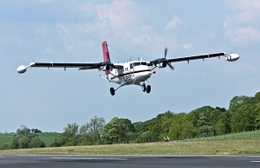
AEMPY – Work-Flow
Conversion to Internal Data Format
FDEM Format
XUTM, YUTM, GPS, RADAR, IP912-24510, Q912-245103,PWLM
TDEM Format
XUTM, YUTM, GPS, RADAR, X1-X11, Z1-Z11
Define Dataset
Flight-line, polygon, profile projection
Input File
Tellus FDEM & TDEM Data
Inversion Along Flight Line
Deterministic Approach
Tikhonov-type inversion
MAP inversion
Truncated SVD Inversion
Stochastic Approach
Markov Chain Monte Carlo
Pre-Processing
- Flag negative values and high-fly areas
- Interpolate
- Average/Block Data over a Number of
Stations
- PCA filtering

Slide 4
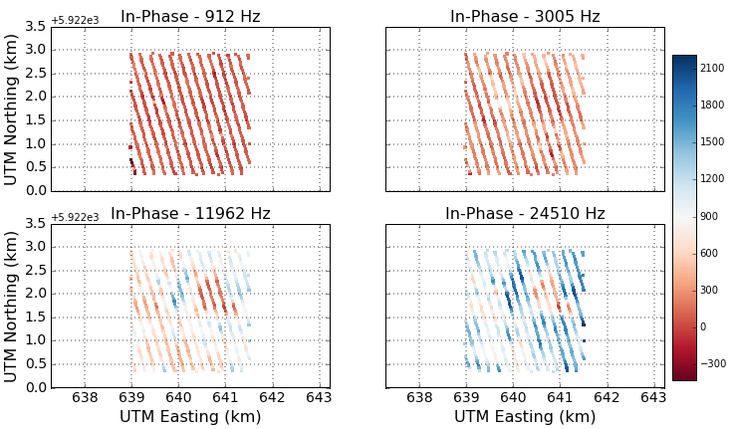
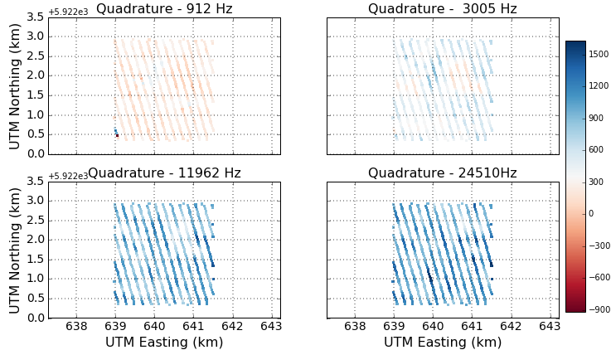
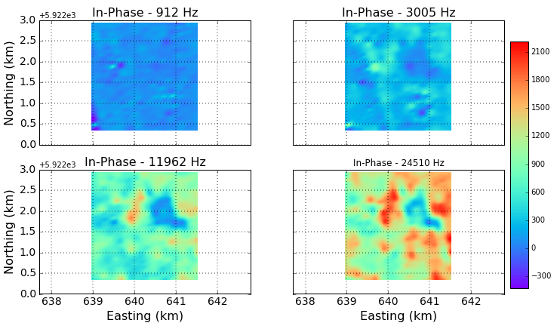
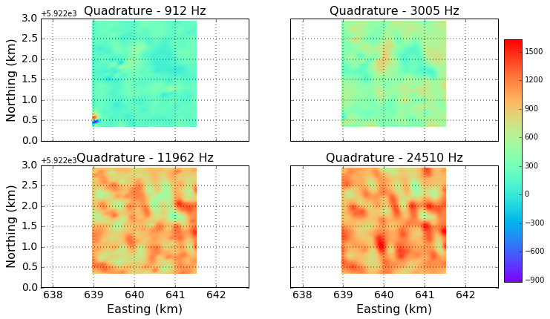
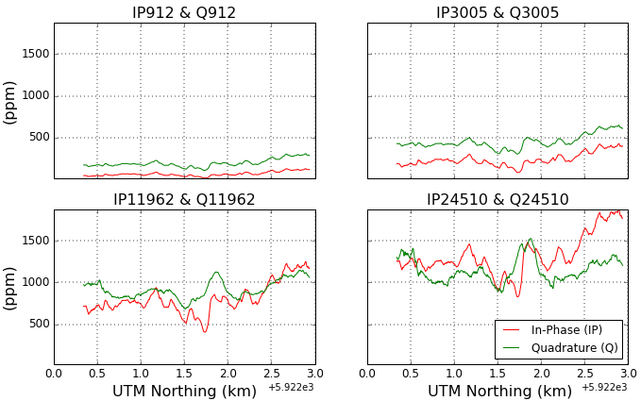
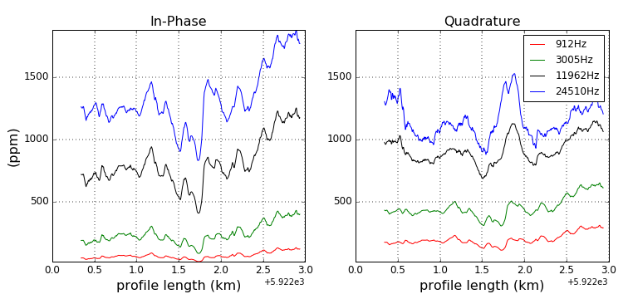
Data Visualisation
Scatter Plots
Interpolate Plots
Along Flight-Lines
Plots

Slide 5
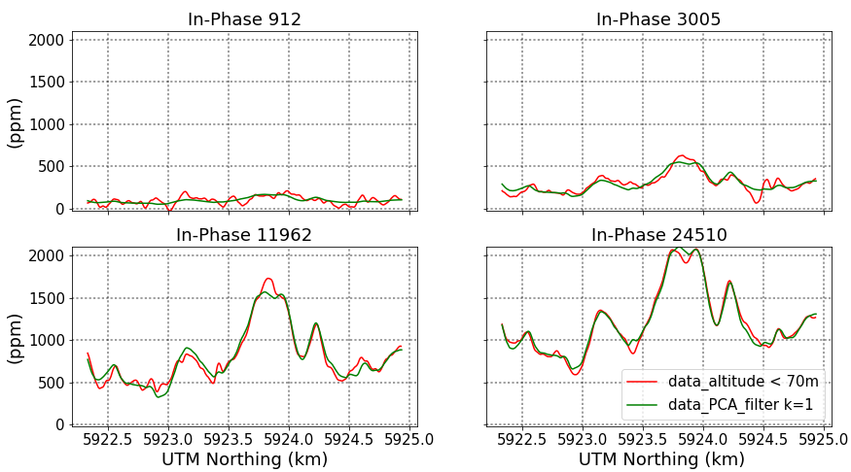
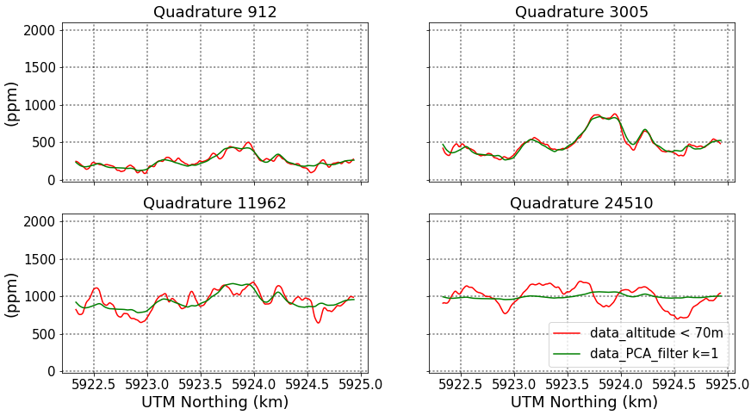
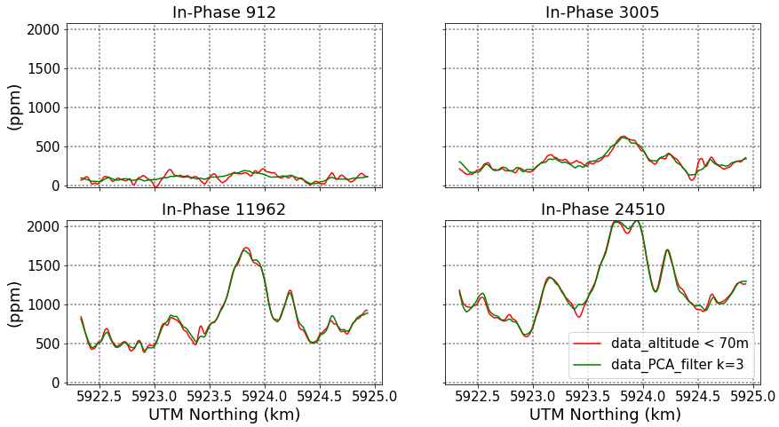
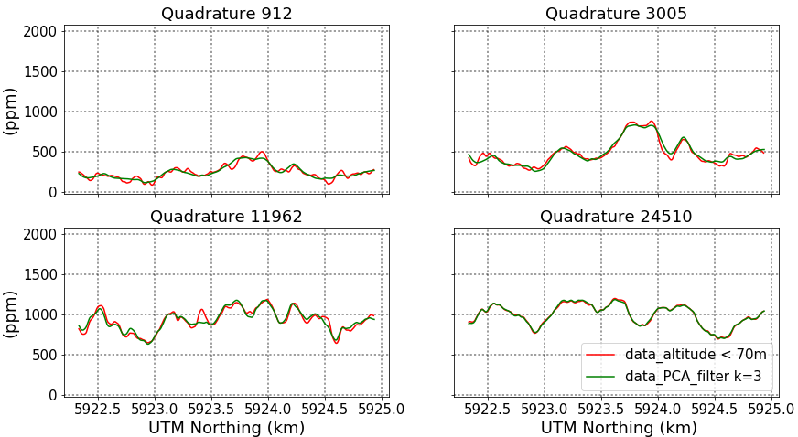
Data Pre-Processing
Remove High Fly data points: e.g., radar data > 70 m
PCA Analysis:
Flight Line: 1379

Slide 6
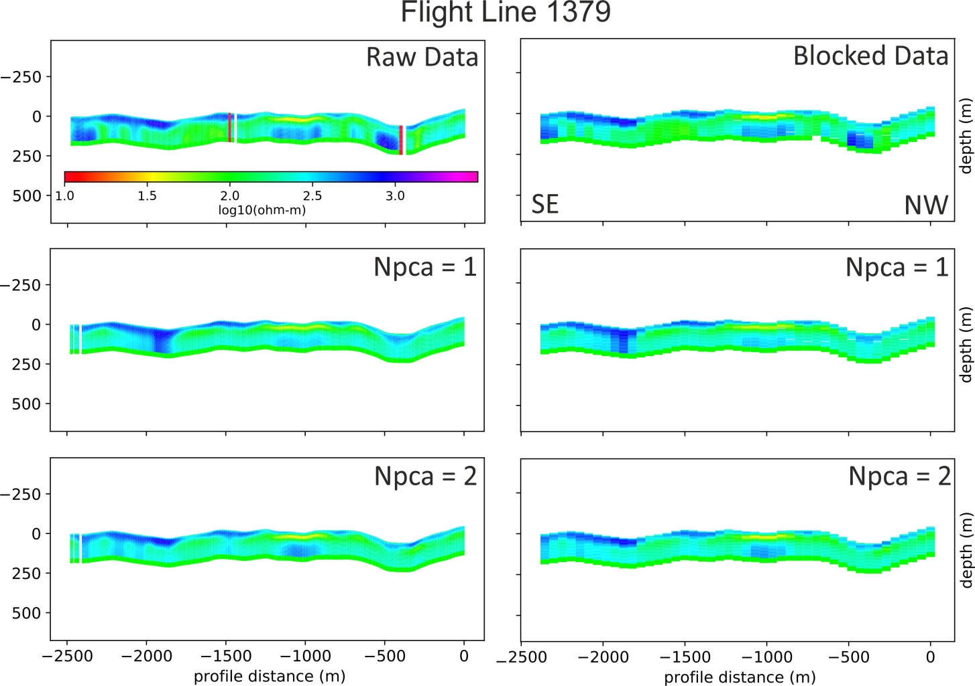
Data Inversion – Along Flight Lines

Slide 7
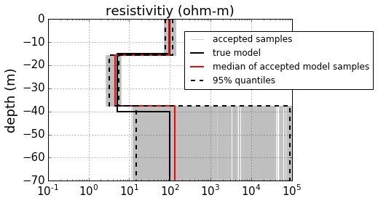
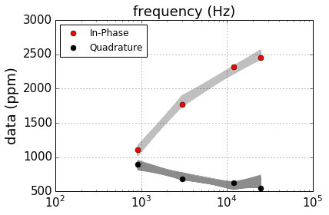
Bayesian MCMC – Synthetic Data
True Model:
100ohm-m
15m
5ohm-m
25m
100 ohm-m
Starting Model:
Assumed Data error : 30 ppm
Frequency-Domain AEM Results

Slide 8
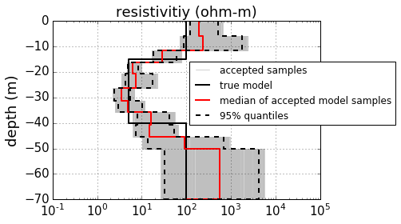
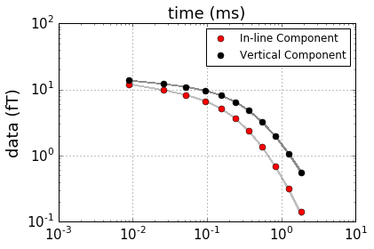
Bayesian MCMC – Synthetic Data
Time-Domain AEM Results

Slide 9
What AEMPY can do?
What AEMPY cannot do?

Slide 10
On-going and Future Work
AEMPY will be presented at the EGU General Assembly in April, 2017
Publication – GSI Tellus Team contribution on test case ?
Time-Domain Airborne EM – how much do we know about …. TO BE COMPLETED

